Slide 1
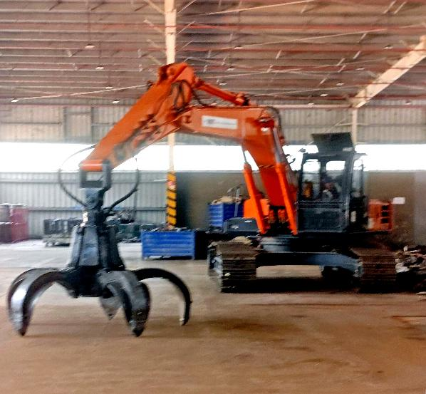
A REPORT ON
Registered Vehicle Scrapping Facilities in India
Status as on 31 October 2026

Slide 2
RVSFs in India- Overview
TOP 10 STATES WITH RVSFs
S. No. | States | Required | RVSF Present
1 | Uttar Pradesh | 17 | 105
2 | Haryana | 11 | 27
3 | Gujarat | 16 | 12
4 | Maharashtra | 26 | 11
5 | Rajasthan | 13 | 8
6 | Madhya Pradesh | 10 | 7
7 | Punjab | 9 | 7
8 | Chhattisgarh | 4 | 7
9 | Bihar | 4 | 7
10 | Uttarakhand | 2 | 5
No. of RVSFs required = state scrapping vehicle number / 20000
241.2%
184.9%
2192.5%
* UK is at 4th place irrespective of having half no. of RVSF to that of MH
Source : vscrap.parivahan.gov.in

Slide 3
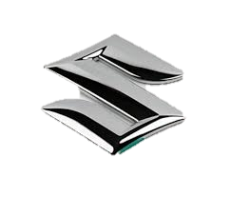



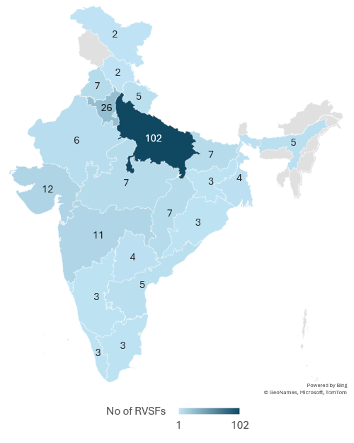
Major OEM RVSFs
OEM Name | S. no. | States | City | RVSF Names | Ownership Details
MSIL | 1 | Uttar Pradesh | Noida | Maruti Suzuki Toyotsu India Pvt Ltd | JV between MSIL and TTC Group
MAHINDRA | 1 | Assam | Guwahati | Mahindra MSTC Recycling Pvt. Ltd. | JV B/w Mahindra Accelo & MSTC Ltd, PSU
 | 2 | Gujarat | Surat
 | 3 | Karnataka | Bangalore
 | 4 | Madhya Pradesh | Indore
 | 5 | Maharashtra | Thane
 | 6 | Tamil Nadu | Walajabad
 | 7 | Uttar Pradesh | Greater Noida
TATA | 1 | Maharashtra | Pune | Tata International Vehicle Applications Pvt Ltd | Run by subsidiary of Tata International
 | 2 | Chhattisgarh | Dharsiwan, | Tata Raipur Green Energy Private Limited | Franchise Model Under Re.Wi.Re
 | 3 | Gujarat | Surat | Tata Shree Ambica Automotive Pvt Ltd
 | 4 | Haryana | Palwal | Tata Johar Motors Private Limited
 | 5 | Assam | Guwahati | Tata Axom Platinum Scrappers Llp
 | 6 | Orissa | Khordha | Tata Empreo Premium
 | 7 | Punjab | Rupnagar | Tata Dada Trading Company
 | 8 | Rajasthan | Jaipur | Tata Ganganagar Vaahan Udyog Pvt Ltd
 | 9 | Uttar Pradesh | Lucknow | Tata Moto Scrapland Pvt. Ltd.
 | 10 | West Bengal | Kolkata | Tata Selladale Synergies (India) Private Limited
 | 11 | Gujrat | Ahmedabad | NA
 | 12 | Bihar | Patna | Kalahanu Bothra Group
TVS | 1 | Karnataka | Bangalore | TVS Motor Company Ltd. | TVS Owned
Source : vscrap.parivahan.gov.in

Slide 4
Top Performing RVSF Pan India | FY 25-26 vs FY 26-27
8%
* Total CoD generated by Seven Star is higher than cumulative total of Tata RVSFs & Mahindra RVSFs.
Source : vscrap.parivahan.gov.in

Slide 5
Top Performing RVSF Pan India | FY 23-24 vs FY 24-25
[ ] – No. of RVSF
Tata & Mahindra – Sum of all RVSF
Total CD – 62,847
MSTI market share – 5.3%
[7]
[5]
[1]
8%
[ ] – No. of RVSF
Tata & Mahindra – Sum of all RVSF
Total CD – 22,054
MSTI market share – 9.7%
[7]
[1]
[5]
Source : vscrap.parivahan.gov.in

Slide 6
Top 10 RVSF BY COD Generation (since inception)
Source : vscrap.parivahan.gov.in

Slide 7
Vehicle Registration & Fitness Extension Policy – India
POLICY FOR FITNESS & RC EXTENSION
Item | Rule
Private car / 2W | RC valid 15 yrs; then renewed every 5 yrs with valid fitness
Commercial vehicle | Fitness every 2 yrs up to 8 yrs old, then every year
Testing centre | Transport vehicles: Automated Testing Station (ATS) only, from 1 Oct 2024
If not renewed | No fitness test within 180 days of expiry → declared ELV in VAHAN (Mar 2024)
Late RC renewal | Monthly penalty: ~₹300 (2W) / ~₹500 (car)
Delhi-NCR | Diesel >10 yrs, petrol >15 yrs barred regardless of fitness (NGT/SC; under SC review)
Fitness test fee (₹) | 10–15 yrs | 15–20 yrs | 20+ yrs
Two-wheeler | 400 | 1,000 | 2,000
Three-wheeler | 600 | 3,000 | 7,000
Car / LMV | 600 | 5,000 | 15,000
Medium goods / passenger | 1,000 | 10,000 | 20,000
Heavy goods / passenger | 1,000 | 12,500 | 25,000
RC renewal >15 yrs | Fee (₹)
Two-wheeler | 1,000
Car | 5,000
Imported bike | 10,000
Imported car | 40,000
If scrapped at RVSF (CoD) | Benefit
RC fee on new vehicle | Waived
MV tax – private | Up to 25%
MV tax – commercial | Up to 15%
BS-I & older | Up to 50%
Source :- Central rates; states may add charges. Sources: CMVR Fifth Amendment (Nov 2025), GSR 714(E) (RC fees from 1 Apr 2022), NITI Aayog ELV report (Jan 2026).

Slide 8
RVSF & Vehicle Scrapping – Key Developments (Sep–Oct 2026)
Date | Development | Key Points | Why it matters
31 Oct 2026 | Delhi names RVSF regulators | Delhi Govt designates registering and appellate authorities for RVSFs Comes -5 years after MoRTH notified the RVSF Rules, 2021 Delhi has only 3 approved RVSFs; just 1 operational, with heavy backlog | Clear approval route for new RVSF applicants in Delhi; capacity gap remains large
28 Oct 2026 | PARIVARTAN Transport Mela, Burari | MoRTH + Delhi Govt single venue for old truck & bus owners (OEMs, RVSFs, banks, OMCs) Incentives: min 8% OEM discount, 5% loan interest subvention, 100% road tax concession for 10 yrs, fuel vouchers, registration fee waiver ~40,000 beneficiaries registered on PARIVARTAN portal | Strong pull of old CVs from Delhi-NCR into RVSFs
21 Sep 2026 | Eicher (VECV) × Rosmerta tie-up | Eicher dealers & customers in NCR routed to Rosmerta RVSF (Manesar) Covers PARIVARTAN paperwork, digital CoD, depollution, dismantling Includes EPR credit generation and transfer 4.3 lakh+ vehicles scrapped via RVSFs so far | OEM–RVSF partnerships becoming the main channel for vehicle inflow and EPR credits
Source: The Tribune (31 Oct 2026) | MoRTH Transport Mela brief (26 Oct 2026) | Autocar Pro (21 Sep 2026)

Slide 9
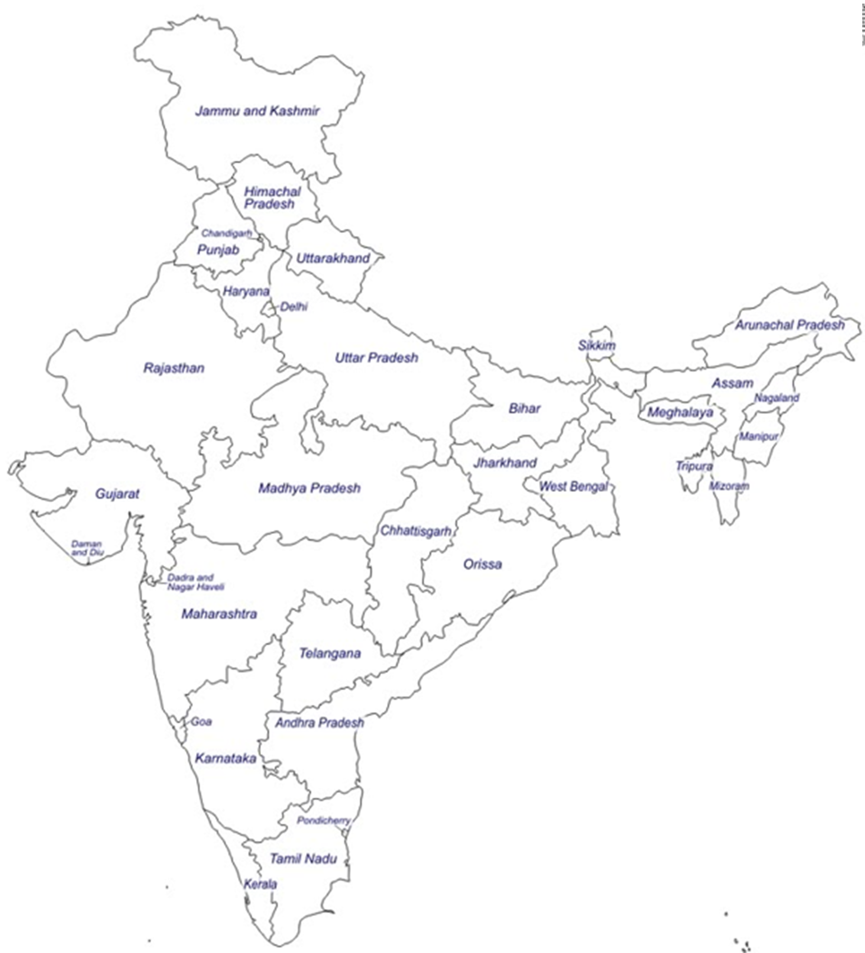

TATA owned RVSFs Performance (FY2026-27)
2
7
3
9
11
12
4
1
6
5
8
*11 & 12 RVSF – Approved & non Operational
Source : vscrap.parivahan.gov.in

Slide 10
Mahindra MSTC Recycling Pvt Ltd Performance (FY2026-27)
3
5
4
2
7
1
6
Source : vscrap.parivahan.gov.in

Slide 11
Back Up

Slide 12

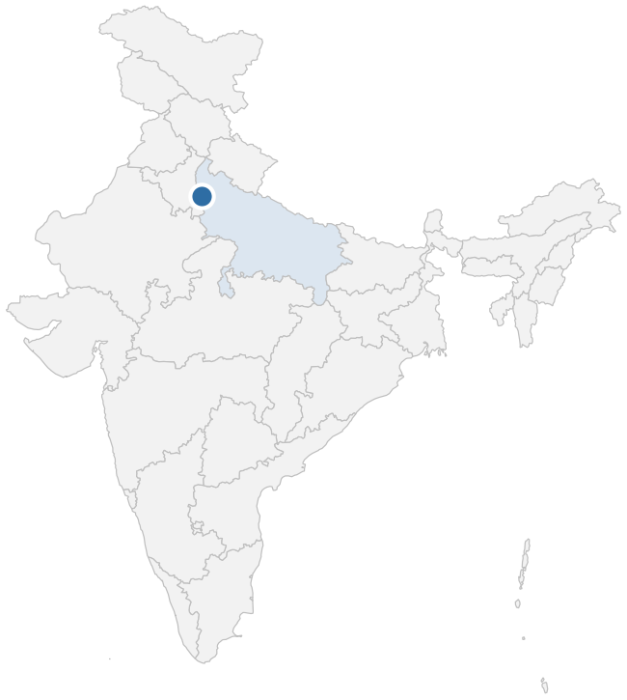
01 Seven Star Auto Scraping India Pvt Ltd
Ghaziabad, Uttar Pradesh | Established 2023 | Operational since 2023
Certificates of Deposit (CDs)
MSIL dealers nearby
Dealer | km
SNV Automobiles | 8
Motorcraft Sales | 6
Maruti Suzuki Arena | 4
Material ecosystem
Category | Nearest local source | MSIL-approved source
Steel mill | Kathuria Rollmill Pvt Ltd (10 km) | Vardhman Steel, Ludhiana, PB
Plastic raw material | Seamer Synthetics (8 km) | Kingfa, MPL – Manesar
Plastic recycler | Greenlink Recyclers Pvt Ltd (15 km) | Peeco Polytech Pvt Ltd
Aluminium smelter | Bindal Smelting Pvt Ltd (34 km) | —
MSIL plant | — | MSIL-G, MSIL-M, MSIL-K

Slide 13

02 Bharat Scrap Facilities
Bulandshahar, Uttar Pradesh | Established 2023 | Operational since 2023
Certificates of Deposit (CDs)
MSIL dealers nearby
Dealer | km
SK Universe | 5, 21
Rana Motors | 19
Material ecosystem
Category | Nearest local source | MSIL-approved source
Steel mill | Dongkuk Steel India (23 km) | Vardhman Steel, Ludhiana, PB
Plastic raw material | Shivam Plastics (72 km) | Kingfa, MPL – Manesar
Plastic recycler | AR Plastic Management (26 km) | Peeco Polytech Pvt Ltd
Aluminium smelter | Bindal Smelting Pvt Ltd (26 km) | —
MSIL plant | — | MSIL-G, MSIL-M, MSIL-K

Slide 14
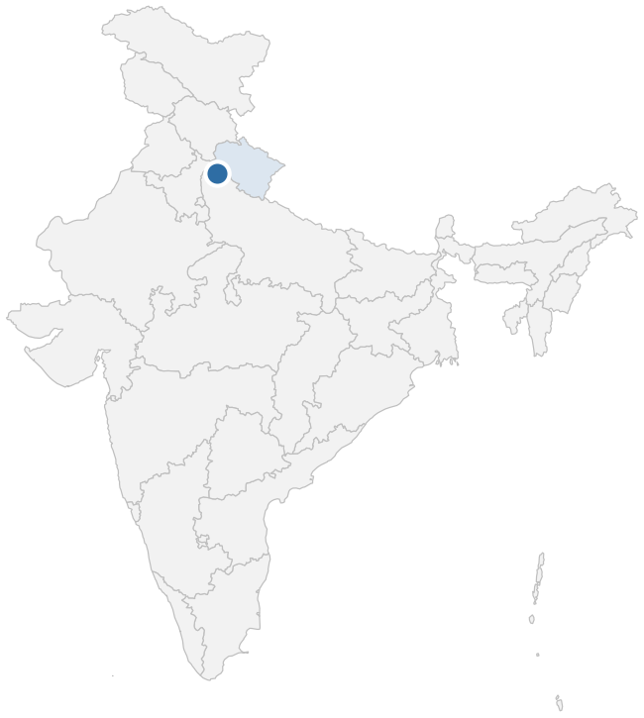
03 Sega Tech Solution Pvt Ltd
Roorkee, Uttarakhand | Established 2022 | Operational since 2023
Certificates of Deposit (CDs)
MSIL dealers nearby
Dealer | km
Shakumbari Automobiles Pvt Ltd | 7, 20, 23
Material ecosystem
Category | Nearest local source | MSIL-approved source
Steel mill | Tehri Iron & Steel Industries (75 km) | Vardhman Steel, Ludhiana, PB
Plastic raw material | Glow Pet Products Pvt Ltd (10 km) | Kingfa, MPL – Manesar
Plastic recycler | Root Recycling (15 km) | Peeco Polytech Pvt Ltd
Aluminium smelter | — | —
MSIL plant | — | MSIL-G, MSIL-M, MSIL-K

Slide 15
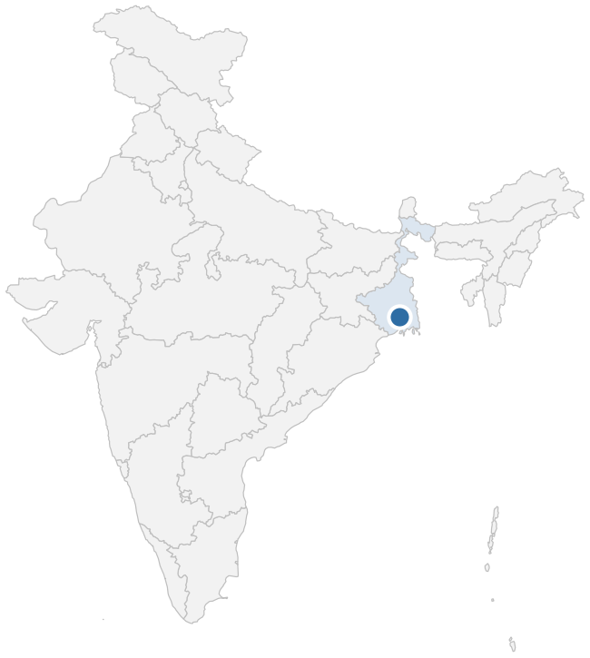
04 Eccel Exports Pvt Ltd
Howrah, West Bengal | Established 2018 | Operational since 2023
Certificates of Deposit (CDs)
MSIL dealers nearby
Dealer | km
Bhandari Automobiles Pvt Ltd | 8, 14, 17
Sanei Motors Pvt Ltd | 19
Material ecosystem
Category | Nearest local source | MSIL-approved source
Steel mill | Jindal India Ltd (15 km) | Tata Steel Long Products, Jamshedpur (282 km)
Plastic raw material | Jai Maa Durga Traders (20 km) | MPL, Dhar, MP
Plastic recycler | Rajshree Recycling Metals (30 km) | Green Earth Sustainability
Aluminium smelter | Hindalco Industries Ltd (25 km) | —
MSIL plant | — | MSIL-G (1,549 km)

Slide 16
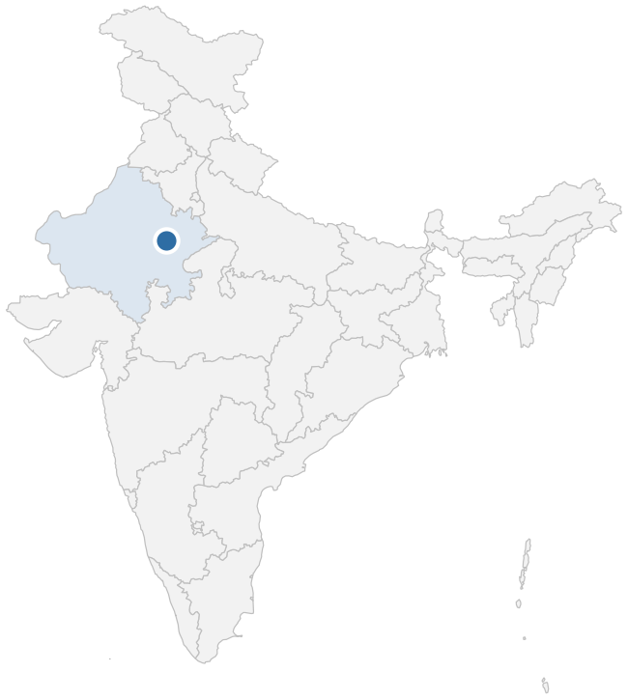
05 Wortech Engineers Pvt Ltd
Jaipur, Rajasthan | Established 2022 | Operational since 2023
Certificates of Deposit (CDs)
MSIL dealers nearby
Dealer | km
Prem Motors Pvt Ltd | 18
Sanga Autonation | 28, 34
Material ecosystem
Category | Nearest local source | MSIL-approved source
Steel mill | Shree Krishna Rolling Mills (Jaipur) Ltd (65 km) | Vardhman Steel, Ludhiana, PB (569 km)
Plastic raw material | Gravita India Ltd (15 km) | ACI, Jaipur, RJ (30 km)
Plastic recycler | Rajasthan Poly Pack (0.5 km) | Peeco Polytech Pvt Ltd (408 km)
Aluminium smelter | Gravita India Ltd (15 km) | —
MSIL plant | — | MSIL-G, MSIL-M, MSIL-K (310 km)

Slide 17

06 Kaka Vehicle Fitness & Testing Centre Pvt Ltd
Moradabad, Uttar Pradesh | Established 2022 | Operational since 2024
Certificates of Deposit (CDs)
MSIL dealers nearby
Dealer | km
Amar Cars Pvt Ltd | 8
Kataria Automobiles Pvt Ltd | 15, 18
Tanu Motors Pvt Ltd | 17
Material ecosystem
Category | Nearest local source | MSIL-approved source
Steel mill | Bharat Metals (10 km) | Vardhman Steel, Ludhiana, PB
Plastic raw material | Mahadev Polymers (15 km) | Kingfa, MPL – Manesar
Plastic recycler | Nazar Rashid Traders (15 km) | Peeco Polytech Pvt Ltd
Aluminium smelter | N.H Metals (20 km) | —
MSIL plant | — | MSIL-G, MSIL-M, MSIL-K

Slide 18
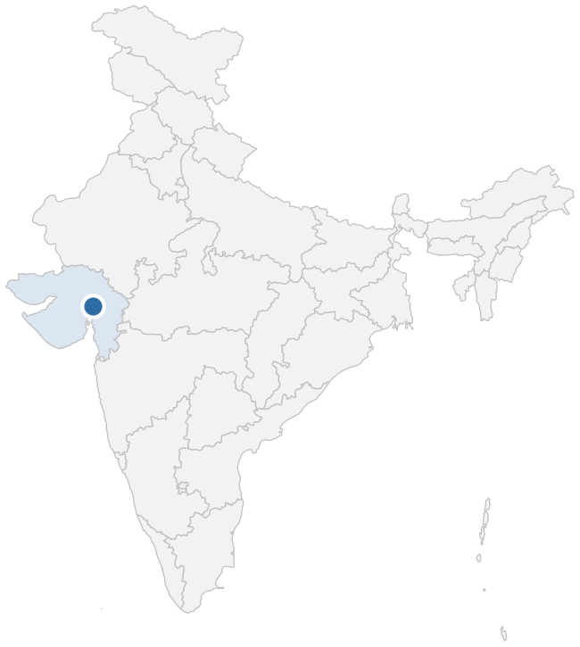
07 CMR Kataria Recycling Pvt Ltd
Kheda, Gujarat | Established 2020 | Operational since 2022
Certificates of Deposit (CDs)
MSIL dealers nearby
Dealer | km
Amar Cars Pvt Ltd | 8
Kataria Automobiles Pvt Ltd | 15, 18
Tanu Motors Pvt Ltd | 17
Monthly average: FY25-26 343 → FY26-27 319 (-7%)
Material ecosystem
Category | Nearest local source | MSIL-approved source
Steel mill | N Steels Pvt Ltd, Kheda (10 km) | Sanyo Special Steel, Khopoli, MH (600 km)
Plastic raw material | Naaz Traders, Kheda (1 km) | MPL, Dhar, MP (360 km)
Plastic recycler | Star Recycling (2 km) | Green Earth Sustainability (60 km)
Aluminium smelter | Malco Aluminium Pvt Ltd (20 km) | —
MSIL plant | — | SMG (101 km)

Slide 19
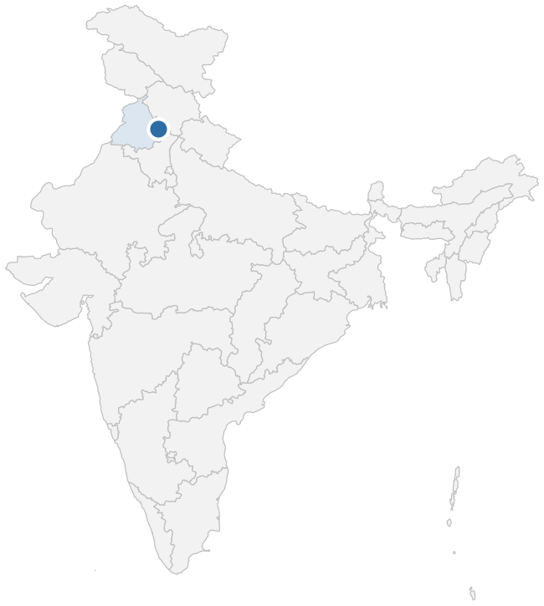
08 Dada Trading Company (TATA)
Rupnagar, Punjab | Established 2023 | Operational since 2023
Certificates of Deposit (CDs)
MSIL dealers nearby
Dealer | km
Jayalakshmi Automotives Pvt Ltd | 11, 23, 24
Material ecosystem
Category | Nearest local source | MSIL-approved source
Steel mill | Soorma Steel (20 km) | Vardhman Steel, Ludhiana, PB
Plastic raw material | Preet Trading Company (20 km) | Kingfa, MPL – Manesar
Plastic recycler | Amit Plastic Store (10 km) | Peeco Polytech Pvt Ltd
Aluminium smelter | — | —
MSIL plant | — | MSIL-G, MSIL-M, MSIL-K

Slide 20

09 Select Technical Services
Chandigarh | Established 2017 | Operational since 2023
Certificates of Deposit (CDs)
MSIL dealers nearby
Dealer | km
Modern Automobiles | 5, 6
Autovogue Pvt Ltd | 7
Material ecosystem
Category | Nearest local source | MSIL-approved source
Steel mill | Taj Steel Fabrication (2 km) | Vardhman Steel, Ludhiana, PB
Plastic raw material | United Polymer Industries (0.5 km) | Kingfa, MPL – Manesar
Plastic recycler | Rajasthan Poly Pack (0.5 km) | Peeco Polytech Pvt Ltd
Aluminium smelter | Sana Smelter Pvt Ltd (2 km) | —
MSIL plant | — | MSIL-G, MSIL-M, MSIL-K

Slide 21

10 Global Scrappage Yards
Mohali, Punjab | Established 2022 | Operational since 2023
Certificates of Deposit (CDs)
MSIL dealers nearby
Dealer | km
Autopace Network Pvt Ltd | 4
Tricity Autos | 9
Autovogue Pvt Ltd | 12
Material ecosystem
Category | Nearest local source | MSIL-approved source
Steel mill | Sada Shiv Castings Pvt Ltd (2 km) | Vardhman Steel, Ludhiana, PB
Plastic raw material | Nirmal Pet, Derabassi (6.5 km) | Kingfa, MPL – Manesar
Plastic recycler | Aqua Fiber Industries (5 km) | Peeco Polytech Pvt Ltd
Aluminium smelter | — | —
MSIL plant | — | MSIL-G, MSIL-M, MSIL-K

Slide 22
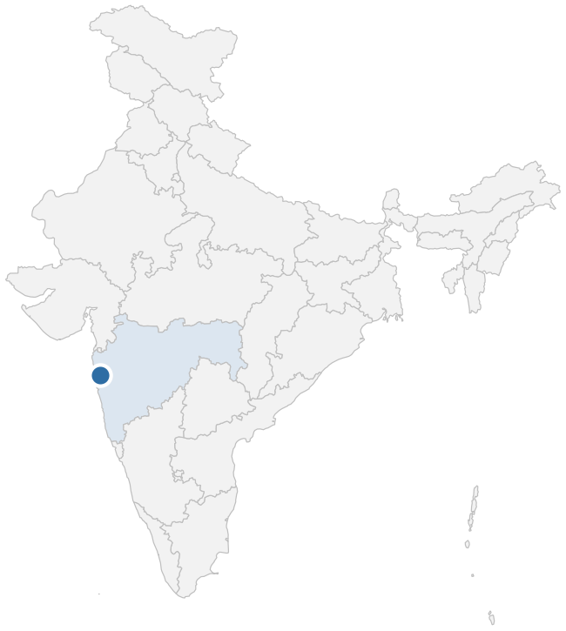
11 Automotive Manufacturers Pvt Ltd
Raigad, Maharashtra | Established 2022 | Operational since 2023
Certificates of Deposit (CDs)
MSIL dealers nearby
Dealer | km
Shakumbari Automobiles Pvt Ltd | 7, 20, 23
Material ecosystem
Category | Nearest local source | MSIL-approved source
Steel mill | Mahindra Sanyo Special Steel Pvt Ltd (13 km) | ISMT, Jejuri, MH (170 km)
Plastic raw material | Bajaj Polyblends Pvt Ltd (25 km) | Kingfa, Pune, MH (100 km)
Plastic recycler | Re Sustainability Ltd (40 km) | Green Earth Sustainability (609 km)
Aluminium smelter | Hindalco Industries Ltd (40 km) | —
MSIL plant | — | SMG (651 km)

Slide 23

12 MTC Business Pvt Ltd
Sanand, Gujarat | Established 2022 | Operational since 2023
Certificates of Deposit (CDs)
MSIL dealers nearby
Dealer | km
Amar Cars Pvt Ltd | 8
Kataria Automobiles Pvt Ltd | 15, 18
Tanu Motors Pvt Ltd | 17
Material ecosystem
Category | Nearest local source | MSIL-approved source
Steel mill | POSCO India Steel Processing Pvt Ltd (1 km) | Sanyo Special Steel, Khopoli, MH (622 km)
Plastic raw material | Rexaw Recycling Pvt Ltd (3 km) | MPL, Dhar, MP (369 km)
Plastic recycler | Naaz Trading Company (5 km) | Green Earth Sustainability (60 km)
Aluminium smelter | Dhanvanti Engg Pvt Ltd (10 km) | —
MSIL plant | — | SMG (85 km)

Slide 24
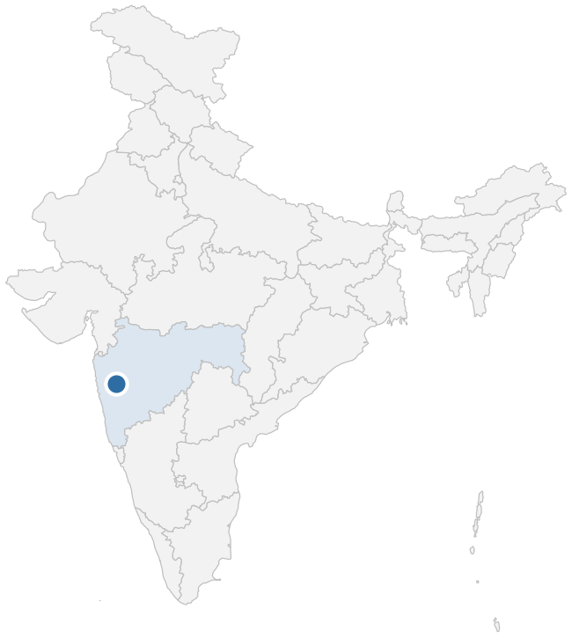
13 Bhosale Automotive
Pune, Maharashtra | Established 2025 | Operational since 2025
Certificates of Deposit (CDs)
MSIL dealers nearby
Dealer | km
My Car | 6
Sumankirti Cars | 8
Wonder Cars | 9
Material ecosystem
Category | Nearest local source | MSIL-approved source
Steel mill | Omega Bright Steel Pvt Ltd (3 km) | ISMT, Jejuri, MH (80 km)
Plastic raw material | Samarth Enterprises (1 km) | Kingfa, Pune, MH (30 km)
Plastic recycler | Indrayani Recyclers LLP (5 km) | Green Earth Sustainability (699 km)
Aluminium smelter | Shreenath Metals (8 km) | —
MSIL plant | — | SMG (741 km)

Slide 25
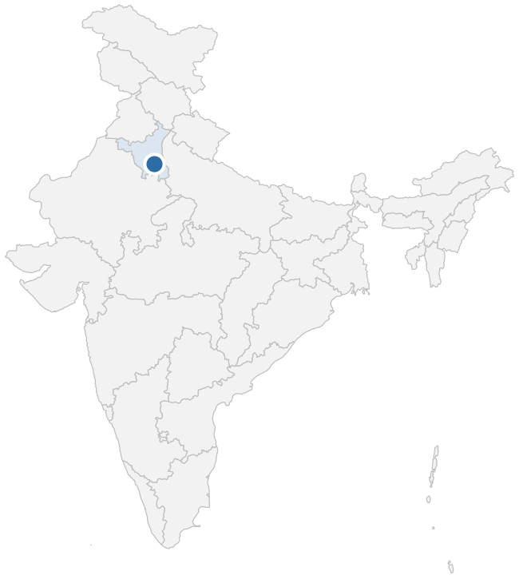
14 Re Sustainability Pvt Ltd
Jhajjar, Haryana | Established 2024 | Operational since 2024
Certificates of Deposit (CDs)
MSIL dealers nearby
Dealer | km
Competent Motors | 2
Platinum Motocorp | 12
Swastik Motocorp | 22
Material ecosystem
Category | Nearest local source | MSIL-approved source
Steel mill | Anand Roller Company (1 km) | Vardhman Steel, Ludhiana, PB (350 km)
Plastic raw material | All Around Polymer LLP (1 km) | Kingfa, MPL – Manesar (30 km)
Plastic recycler | Khushi Plastic (10 km) | Peeco Polytech Pvt Ltd (100 km)
Aluminium smelter | Mars Aluminium Company (2 km) | —
MSIL plant | — | MSIL-G, MSIL-M, MSIL-K (30 km)

Slide 26
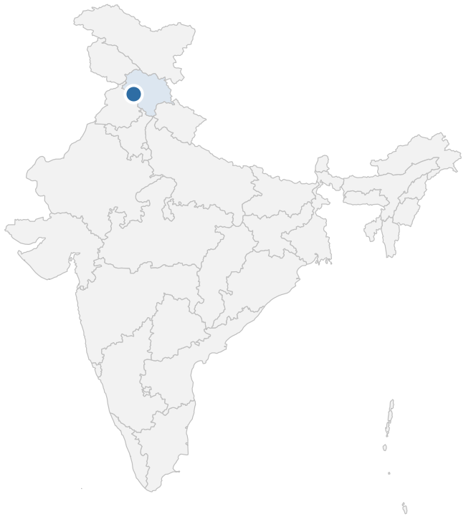
15 Scrap Warriors
Hamirpur, Himachal Pradesh | Established 2020 | Operational since 2025
Certificates of Deposit (CDs)
MSIL dealers nearby
Dealer | km
Competent Automobiles | 8, 40, 46
Material ecosystem
Category | Nearest local source | MSIL-approved source
Steel mill | M S Jai Jawala Steel Industries (45 km) | Vardhman Steel, Ludhiana, PB
Plastic raw material | A S Enterprises (5 km) | Kingfa, MPL – Manesar
Plastic recycler | Eco Works Management Pvt Ltd (30 km) | Peeco Polytech Pvt Ltd
Aluminium smelter | Pentagon Aluminium Pvt Ltd (50 km) | —
MSIL plant | — | MSIL-G, MSIL-M, MSIL-K

Slide 27
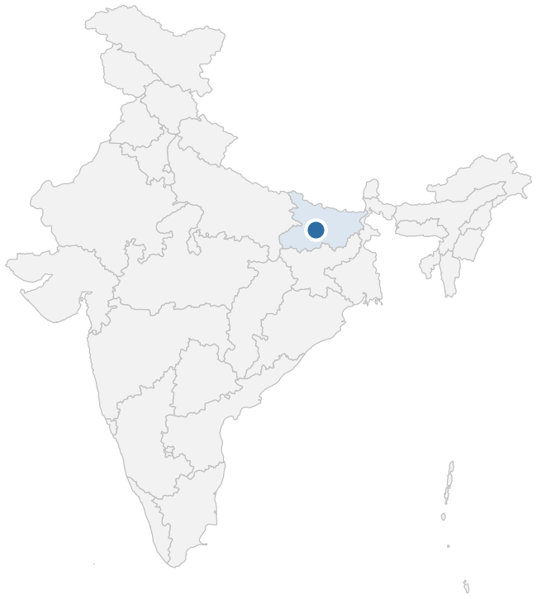
16 Sri Neelayum Precoated Steel
Patna, Bihar | Established 2021 | Operational since 2023
Certificates of Deposit (CDs)
MSIL dealers nearby
Dealer | km
Alankar Auto Sales | 24, 54
Reeshav Automobiles | 38
Material ecosystem
Category | Nearest local source | MSIL-approved source
Steel mill | Super Smelters Ltd (45 km) | Tata Steel Long Products, Jamshedpur, JH
Plastic raw material | Choudhry Enterprises (5 km) | Kingfa, MPL – Manesar
Plastic recycler | Saha & Bright Polytech (20 km) | Peeco Polytech Pvt Ltd
Aluminium smelter | Sana Smelter Pvt Ltd (45 km) | —
MSIL plant | — | MSIL-G, MSIL-M, MSIL-K

Slide 28
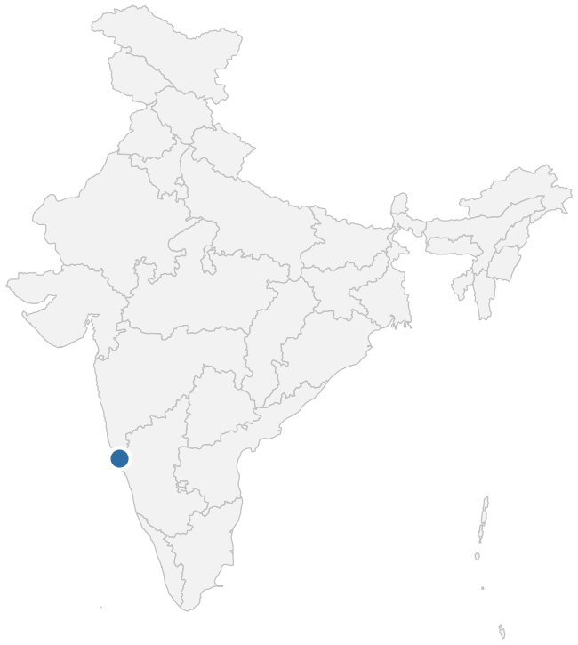
17 Mangal Iron Pvt Ltd
Ponda, Goa | Established 2002 | Operational since 2024
Certificates of Deposit (CDs)
MSIL dealers nearby
Dealer | km
Sai Service | 13
Aryaman Sai | 23
Sai Point | 28
Material ecosystem
Category | Nearest local source | MSIL-approved source
Steel mill | Savitri Steel Industries (0.5 km) | ISMT, Jejuri, MH
Plastic raw material | Ramdev Plastic Industries (0.5 km) | Kingfa, Pune, MH
Plastic recycler | Taj Plastic Products & Traders (10 km) | Green Earth Sustainability
Aluminium smelter | CMR Toyotsu Aluminium India Pvt Ltd (30 km) | —
MSIL plant | — | SMG

Slide 29
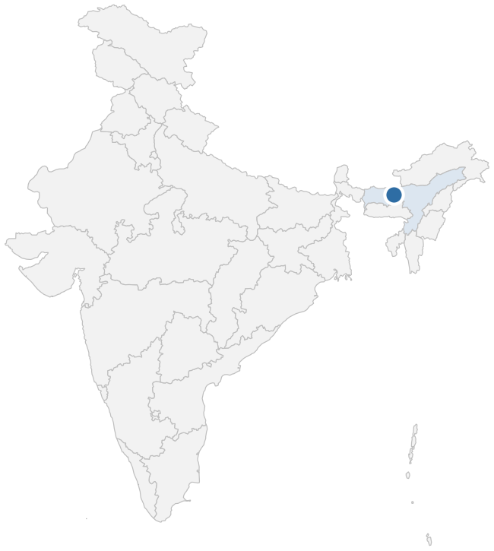
18 KD Ecosystem
Kamrup, Assam | Established 2022 | Operational since 2023
Certificates of Deposit (CDs)
MSIL dealers nearby
Dealer | km
Poddar Car World | 2
Pallavi Motors | 19
Bimal Auto Agency | 20
Material ecosystem
Category | Nearest local source | MSIL-approved source
Steel mill | B R Metallic Pvt Ltd (1 km) | Tata Steel Long Products, Jamshedpur, JH
Plastic raw material | Jai Durga Plastic Stores (5 km) | Kingfa, MPL – Manesar
Plastic recycler | Kusum Udyog (2 km) | Peeco Polytech Pvt Ltd
Aluminium smelter | — | —
MSIL plant | — | MSIL-G, MSIL-M, MSIL-K

Slide 30

19 Abhishek K Kaiho Recyclers Pvt Ltd
Bilaspur, Haryana | Established 2023 | Operational since 2024
Certificates of Deposit (CDs)
MSIL dealers nearby
Dealer | km
Pasco Automobiles | 8
Fortune Cars | 13
Platinum Motocorp | 20
Material ecosystem
Category | Nearest local source | MSIL-approved source
Steel mill | Shri Giriraj Steels Pvt Ltd (13 km) | Vardhman Steel, Ludhiana, PB (350 km)
Plastic raw material | VMK Polychem Pvt Ltd (13 km) | Kingfa, MPL – Manesar (30 km)
Plastic recycler | Green Recycling Waste Management Factory (20 km) | Peeco Polytech Pvt Ltd (100 km)
Aluminium smelter | — | —
MSIL plant | — | MSIL-G, MSIL-M, MSIL-K
Fatehpur, Tauru Road, Bilaspur 122105
akk.net.in

Slide 31
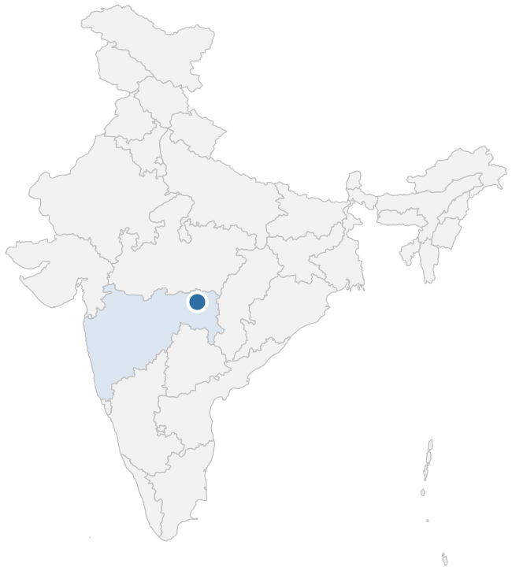
20 Re Vahaan Recyclers Pvt Ltd
Nagpur, Maharashtra | Established 2023 | Operational since 2023
Certificates of Deposit (CDs)
MSIL dealers nearby
Dealer | km
Arya Cars | 4, 11, 12
Material ecosystem
Category | Nearest local source | MSIL-approved source
Steel mill | Orange City Steel Industries (12 km) | Sunflag Steel, Bhandara, MH (56 km)
Plastic raw material | ECO Green Plast (10 km) | Kingfa, Pune, MH (750 km)
Plastic recycler | Ansari Plastic (21 km) | Green Earth Sustainability, GJ (900 km)
Aluminium smelter | Hindalco Industries Ltd (41 km) | —
MSIL plant | — | SMG (1,005 km)
MSIL | Corporate · Confidential
21 / 25

Slide 32
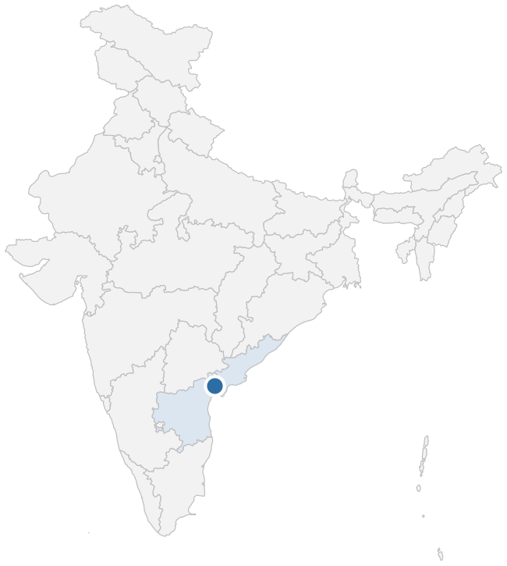
21 Hindustan Recycling Hub
Guntur, Andhra Pradesh | Established 2023 | Operational since 2023
Certificates of Deposit (CDs)
MSIL dealers nearby
Dealer | km
Jayalakshmi Automotives Pvt Ltd | 11, 23, 24
Material ecosystem
Category | Nearest local source | MSIL-approved source
Steel mill | Geeta Devi Steel Industries (2 km) | Arjas Steel, Tadipatri, AP
Plastic raw material | Emerald Plastics (12 km) | Kingfa, Pune, MH
Plastic recycler | YDR Plastic Recycling (12 km) | Green Earth Sustainability (1,605 km)
Aluminium smelter | — | —
MSIL plant | — | SMG

Slide 33
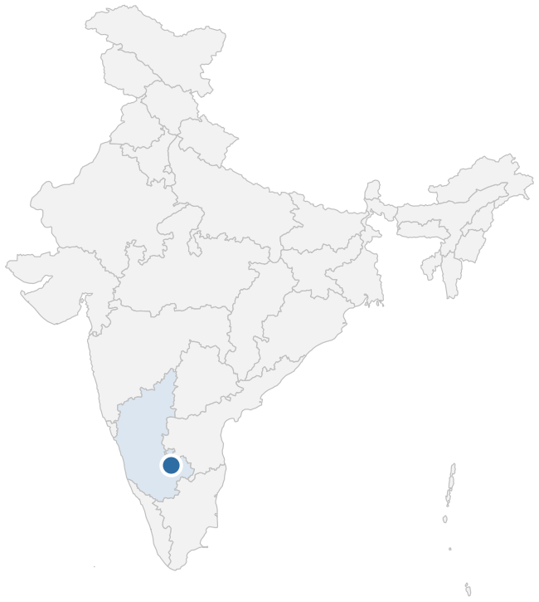
22 Suhas Automotive Pvt Ltd
Tumkur, Karnataka | Established 2016 | Operational since 2023
Certificates of Deposit (CDs)
MSIL dealers nearby
Dealer | km
Saketh Automobiles | 25
Kalyani Motors | 26
Nandan Suzuki | 26
Material ecosystem
Category | Nearest local source | MSIL-approved source
Steel mill | Sunvik Steels Pvt Ltd (40 km) | SLR Metalliks, Bellary, KA
Plastic raw material | Shree Shivganga Enterprise (20 km) | Kingfa, Puducherry
Plastic recycler | Recyklo Plast (30 km) | Green Earth Sustainability
Aluminium smelter | Santech Corporation (40 km) | —
MSIL plant | — | SMG

Slide 34
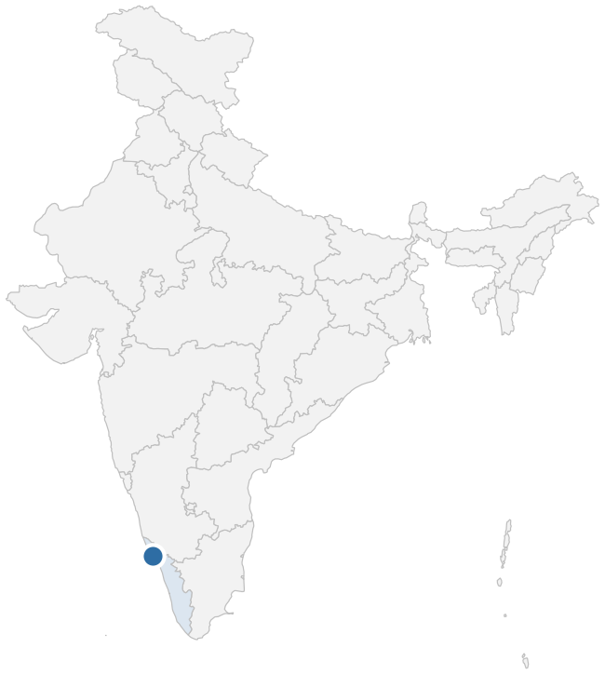
23 SILK RVSF North Zone
Kannur, Kerala | Established 2025 | Operational since 2025
Certificates of Deposit (CDs)
MSIL dealers nearby
Dealer | km
Popular Vehicles & Services Ltd | 6
Indus Motor Co Pvt Ltd | 12
KVR Cars | 12, 13
Material ecosystem
Category | Nearest local source | MSIL-approved source
Steel mill | Steel Industrials Kerala Ltd (on-site) | JSW, Salem, TN (390 km)
Plastic raw material | — | Kingfa, Pune (933 km)
Plastic recycler | — | Green Earth Sustainability (1,605 km)
Aluminium smelter | — | —
MSIL plant | — | MSIL-H

Slide 35
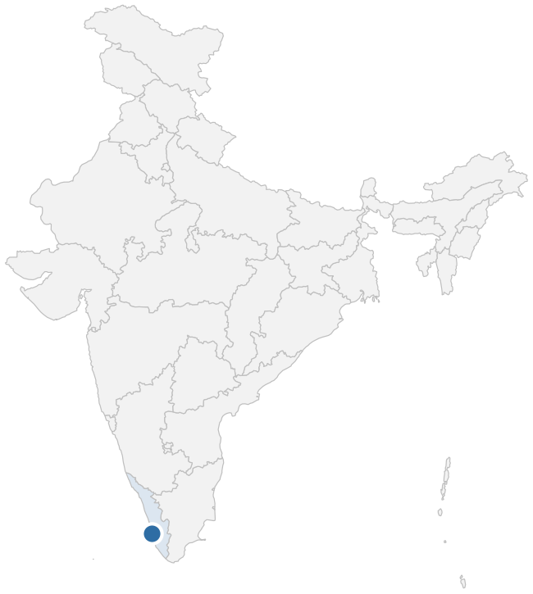
24 SILK RVSF South Zone
Cherthala, Kerala | Established 2025 | Operational since 2025
Certificates of Deposit (CDs)
MSIL dealers nearby
Dealer | km
Indus Motor Co Pvt Ltd | 3
George Maijo Automobiles Pvt Ltd | 6
Popular Vehicles & Services Ltd | 6
Material ecosystem
Category | Nearest local source | MSIL-approved source
Steel mill | Steel Industrials Kerala Ltd (on-site) | JSW, Salem, TN (383 km)
Plastic raw material | — | Kingfa, Pune (1,255 km)
Plastic recycler | — | Green Earth Sustainability (2,038 km)
Aluminium smelter | — | —
MSIL plant | — | MSIL-H

